Slide 1
Yocto 1
Core Concepts
BitBake Language & Recipe Crafting
Tools & Troubleshooting

Slide 2
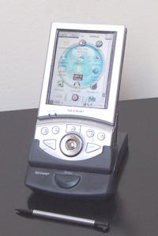
Yocto 1 – OpenEmbedded, or Yocto, or BitBake, or Poky?
OpenEmbedded (2003)
  Evolved from PDA firmware projects in the 90s & early 00s, including:
    OpenZaurus for the Sharp Zaurus
    Familiar Linux for the iPAQ
    OpenSIMpad for the SIMpad
  Recipe- and layer-based build system
Yocto Project (2010)
  Initiated by the Linux Foundation with strong industry/vendor support
  Tightly coupled/aligned with OpenEmbedded community and tooling
BitBake
  OpenEmbedded’s build tool (parses recipes and executes tasks)
  Official build tool of Yocto Project
Poky
  A reference embedded Linux distribution

Slide 3
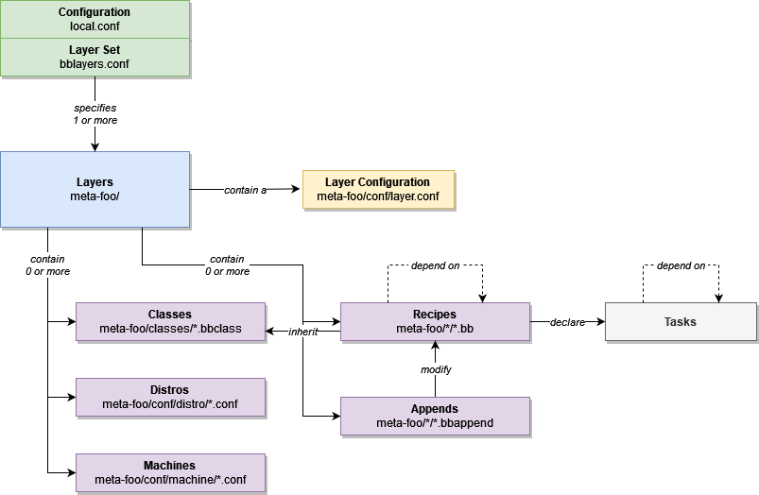
Yocto 1 – Core Concepts (“Data Model”)

Slide 4
Yocto 1 – BitBake Language
Think of BitBake as a glorified set of shell scripts! Except …
  … you can also have Python
  … variable expansion is fancier
  … variables can be overridden/inherited almost like C++
  … most operations are scripted for you, and controlled by variables
Each recipe has its own variable scope
  Variables set in a recipe do not affect other recipes
  Variables set in global configs affect all recipes
If you understand the BitBake language, and how to find the files, you can discover almost all the functionality of BitBake and Yocto
(If you understand Python, and where to look, you can discover the rest – but you may never need to go that deep!)

Slide 5
Yocto 1 – Variable Operations
Variables can be set or modified in several ways:
Simple set: FOO = “bar”
Default set: FOO ?= “bar” (takes effect only if FOO not already set)
Weak default set: FOO ??= “bar” (takes effect only if FOO is nowhere set)
Normally, all variables are lazy-expanded (after all parsing)
Immediate expand: FOO := “${BAR}” (value of BAR taken now, not at the end)
Append/prepend
  Immediate
    With spaces: FOO += “bar”, FOO =+ “bar”
    Without spaces: FOO .= “bar”, FOO =. “bar”
  Lazy
    (Always without spaces) FOO:append = “bar”, FOO:prepend = “bar”
Remove (removes all instances of a whitespace-delimited token)
  FOO:remove = “bar” (always lazy)

Slide 6
Yocto 1 – Variable Overrides
Overrides conditionally set or modify a variable:
  FOO:aarch64 = “bar”
Can be combined with modifiers:
  FOO:aarch64 += “bar”
  FOO:remove:aarch64 = “bar”
You can add anything to the overrides list:
  OVERRIDES .= “:foo”
The default list includes:
  CLASSOVERRIDE ?= “class-target”
  MACHINEOVERRIDES ?= “${MACHINE}”
  DISTROOVERRIDES ?= “${DISTRO}”

Slide 7
Yocto 1 – Parsing Order
Note: Some obscure steps are omitted… see link above for full list
site.conf
auto.conf
local.conf
machine/${MACHINE}.conf
distro/${DISTRO}.conf
machine config
distro config
recipe (*.bb)
appends (*.bbappend), in layer order

Slide 8
Yocto 1 – Key Variables
Recipe Metadata
  DESCRIPTION – description of the package
  PN – package name
  BPN – base package name, with suffixes like -native removed
  PV – package version (can be automatically set from recipe .bb filename)
Directories
  WORKDIR – top working directory for recipe: ${TMPDIR}/work/${MULTIMACH_TARGET_SYS}/${PN}/${EXTENDPE}${PV}-${PR}
  S – location of unpacked source code: ${WORKDIR}/${BPN}-${PV}
  D – “destination” directory where files should be “installed”: ${WORKDIR}/image
  B – build directory: ${WORKDIR}/${BP}
  DEPLOYDIR – target directory for deploy class: ${WORKDIR}/deploy-${PN}
    Do not confuse with DEPLOY_DIR (${TMPDIR}/deploy)!
Source
  SRC_URI – URIs of source files/archives to be fetched / cloned and extracted
  SRCREV (for Git repos) – revision (commit hash or tag) to check out
CMake
  EXTRA_OECMAKE – extra CMake command line options

Slide 9
Yocto 1 – Tasks – Typical/Core
build – the default task
  doesn’t actually build (or do) anything (don’t try!)
  placeholder that depends on all other tasks
fetch – downloads source
unpack – unpacks fetched source (e.g., extract tarball)
patch – applies any .patch files in SRC_URI
configure – prepares the source for building
compile – compiles package in build directory
install – installs files to a staging directory
package
deploy (only with inherit deploy)
There are many more, but these are rarely modified

Slide 10
Yocto 1 – Tasks – Adding Custom Tasks
addtask rub_genie after do_configure before do_compile
do_rub_genie() {
# shell script here
}
python do_rub_genie() {
# python script here
}
Tasks have their own dependencies:
  do_rub_genie[depends] += “foo:do_deploy”
Task functions (built-in or custom) can be modified with append/prepend, overrides, etc., just like variables

Slide 11
Yocto 1 – Packaging
“Staged” recipes are packaged for later use
  … maybe included in rootfs
  … maybe exposed to another recipe in its recipe-sysroot (so the other recipe can link to a library, for example)
Several package formats are supported
  .ipk, .rpm, .deb
For each supported package format, several packages are generated:
  ${PN} – contains stuff that should be installed in rootfs (executables, shared libs, resource files)
  ${PN}-dbg – contains unstripped (with symbols) variant of the above
  ${PN}-dev – contains stuff that another recipe would need: header files, static libraries (goes into recipe-sysroot)
  ${PN}-src – contains the source code that was used to build

Slide 12
Yocto 1 – Tools
See variable values for a recipe: bitbake -e [-c taskname] recipename
List all layers: bitbake-layers show-layers
List recipes: bitbake-layers show-recipes [-f] [recipename]
Graphically explore dependency tree: bitbake -g -u taskexp [-c taskname] recipename
Open shell: bitbake -c devshell recipename

Slide 13
Yocto 1 – devtool
devtool modify: Temporarily hacks layers & appends, so that a package is built from a local source directory instead of fetched URIs (tarballs or Git repositories)
  Creates a local workspace layer in build/workspace and adds this layer to bblayers.conf (be careful not to commit this!)
  Fetches and extracts SRC_URI into build/workspace/${PN}
  Creates a .bbappend in the build/workspace layer
    Uses externalsrc.bbclass, just like e.g. FB_LOCAL_PATH
  Has some issues with e.g. multiple Git repositories in SRC_URI
devtool update-recipe – Creates patch files for any local modifications and updates the .bb (or makes a .bbappend) to include the patch
  Isn’t always smart about where to put files – especially when “dynamic layers” are involved

Slide 14
Yocto 1 – Digging In & Troubleshooting
What’s installed in the rootfs?
  image recipes generate a .manifest file in ${DEPLOY_DIR_IMAGE} (tmp/deploy/images/${MACHINE})
What does a package install?
  Check its package file
    rpm -qlp tmp/deploy/rpm/*/*.rpm
    dpkg -c tmp/deploy/ipk/*/*.ipk (or this workaround if dpkg not installed)
  Run bitbake -c install recipename
    Look in tmp/work/*/recipename-*/image
Why is a step failing?
  Check environment (bitbake -e recipename)
  Try a devshell (bitbake -c devshell recipename)

Slide 15
Yocto 1 – Questions?
Thanks for your time!

